Slide 1
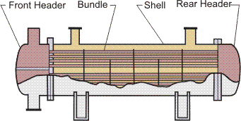
Shell & Tube Heat Exchanger
Front Header—this is where the fluid enters the tubeside of the exchanger. It is sometimes referred to as the Stationary Header.
Rear Header—this is where the tubeside fluid leaves the exchanger or where it is returned to the front header in exchangers with multiple tubeside passes.
Tube bundle—this comprises of the tubes, tube sheets, baffles and tie rods etc. to hold the bundle together.
Shell—this contains the tube bundle.

Slide 2
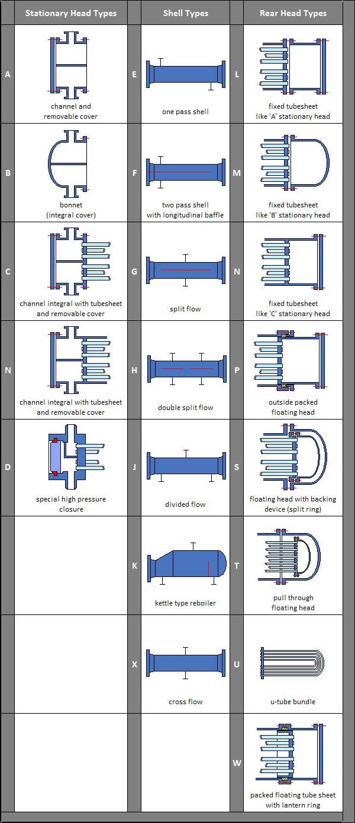
Types of shells, front end & rear ends
http://www.wermac.org/equipment/heatexchanger_part5.html

Slide 3
These are used for entrance and exit of the tube fluid; in many rear-end heads, a provision has been made to take care of tube thermal expansion. The front-end head is stationary, while the rear-end head could be either stationary (allowing for no tube thermal expansion) or floating, depending on the thermal stresses between the tubes and shell. The major criteria for selection of the front-end head are cost, maintenance and inspection, hazard due to mixing of shell and tube fluids, and leakage to ambient and operating pressures. The major criteria for selection of the rear-end head are the allowance for thermal stresses, a provision to remove the tube bundle for cleaning the shell side, prevention of mixing of tube and shell fluids, and sealing any leakage path for the shell fluid to ambient.
Front- and Rear-End Heads

Slide 4
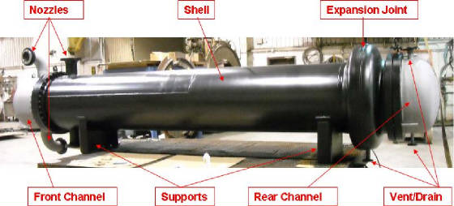
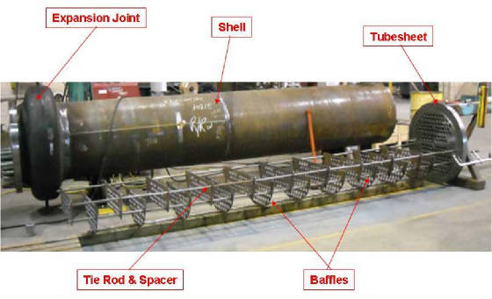
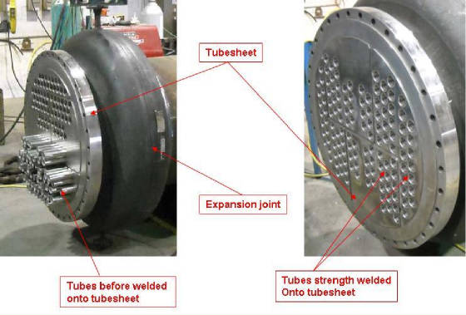
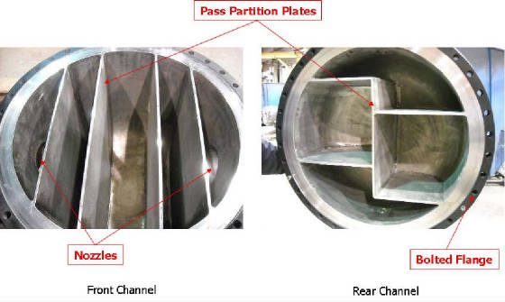
Parts of HE

Slide 5
Classifications of Heat Exchangers

Slide 6
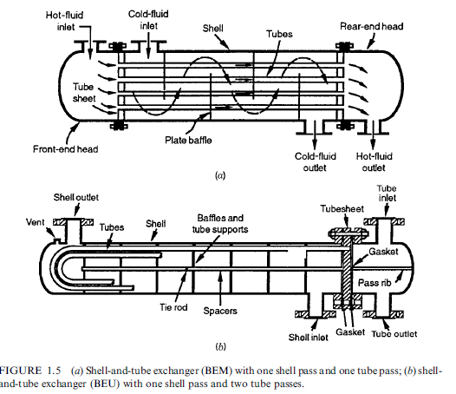
Ref: Shah & Sekulic, 2003

Slide 7
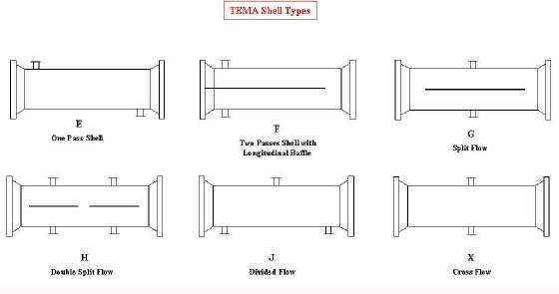
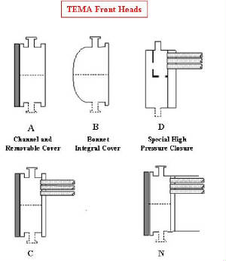
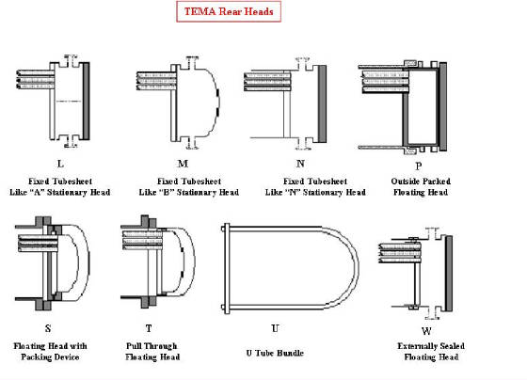
http://www.hcheattransfer.com/shell_and_tube.html

Slide 8
Classifications of Heat Exchangers

Slide 9
Thermal design consideration
Flow rates of both hot & cold streams, their terminal temperatures & fluid properties are primary inputs
Thermal design of a shell & tube HE typically includes :
Determination of heat transfer area
Number of tubes
Tube length & diameter
Tube layout
Number of shell & tube passes
Type of HE ( fixed tube sheet, removable tube bundle, etc.)
Tube pitch
Number of baffles
Type & size
Tube side pressure drop
The selection of an appropriate shell and tube heat exchanger is achieved by a judicious choice of exchanger configuration, geometrical parameters, materials, and the ‘‘right’’ design

Slide 10
Thermal design consideration
Shell:
Container for shell fluid; tube bundle placed inside shell
Shell diameter should be selected in such a way to give a close fit of tube bundle
Clearance between tube bundle & inner shell wall depends on type of exchanger
Shells are usually fabricated from standard steel pipe with satisfactory corrosion allowance
Shell thickness of 3/8 inch for shell ID of 12-24 inch can be satisfactorily used to 300 psi of operating pressure

Slide 11
Thermal design consideration
Tube:
OD of ¾ & 1 inch are common to design a compact heat exchanger
Most efficient condition for heat transfer: maximum number of tubes in shell to increase turbulence
Tube thickness should be enough to withstand internal pressure along with adequate corrosion allowance
Tube thickness expressed in terms of BWG (Birmingham Wire Gauge) & true outside diameter (OD)
Tube length of 6, 8, 12, 16, 20 and 24 ft are preferably used. Longer tube reduces shell diameter at expense of higher shell pressure drop
Finned tubes are also used when fluid with low heat transfer coefficient flows in shell side

Slide 12
Thermal design consideration
Tube pitch, tube layout ad tube-count:
Tube pitch:
shortest centre to centre distance between adjacent tubes
tubes are generally placed in square / triangular patterns (pitch)

Slide 13
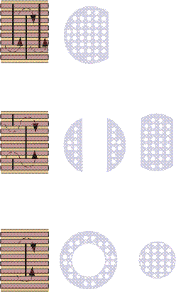
Baffles are installed on the shell side to give a higher
heat-transfer rate due to increased turbulence and to support
the tubes thus reducing the chance of damage due to vibration.
Single Segmental (this is the most common),
Double Segmental (this is used to obtain a lower shell side
velocity and pressure drop),
Disc and Doughnut

Slide 14
Thermal design consideration
Baffles:
Used to increase fluid velocity by diverting flow across tube bundle to obtain higher transfer co-efficient
Distance between adjacent baffles is called baffle-spacing. Baffle spacing of 0.2 - 1 times of inside shell diameter is commonly used
Baffles are held in positioned by means of baffle spacers
Closer baffle spacing gives greater transfer co-efficient by inducing higher turbulence

Slide 15
Thermal design consideration
Tube passes:
Number of passes is chosen to get required tube side fluid velocity to obtain greater heat transfer co-efficient & also to reduce scale formation
Tube passes vary from 1-16
Tube passes of 1, 2 and 4 are common in application

Slide 16
Thermal design consideration
Tube sheet:
Tubes are fixed with tube sheet that form barrier between tube & shell fluids
Tube sheet thickness should be greater than tube outside diameter to make a good seal
Recommended standards (IS:4503 or TEMA) should be followed to select minimum tube sheet thickness

Slide 17
Thermal design consideration
Fouling considerations:
Material deposited reduces effective heat transfer rate due to relatively low thermal conductivity, hence net heat transfer with clean surface should be higher to compensate the reduction in performance during operation
Fouling of exchanger increases cost of:
construction due to oversizing
additional energy due to poor exchanger performance
cleaning to remove deposited materials
Effect of fouling is considered in heat exchanger design by including tube side and shell side fouling resistances

Slide 18
Thermal design consideration
Typical values of fouling coefficients and resistances:

Slide 19
Thermal design consideration
Selection of fluids for tube & shell side:
Routing of shell side & tube side fluids has considerable effects on heat exchanger design. Some general guidelines for positioning the fluids are given :

Slide 20
Thermal Design Basics
The thermal design of a shell and tube exchanger is an iterative process which is normally carried out using computer programs from organizations such as the Heat transfer and Fluid Flow Service (HTFS) or Heat Transfer Research Incorporated (HTRI).
However, it is important that the engineer understands the logic behind the calculation.
In order to calculate the heat transfer coefficients and pressure drops, initial decisions must be made on the sides the fluids are allocated, the front and rear header type, shell type, baffle type, tube diameter and tube layout.
The tube length, shell diameter, baffle pitch and number of tube passes are also selected and these are normally the main items that are altered during each iteration in order to maximize the overall heat transfer within specified allowable pressure drops.

Slide 21
Process (Thermal) Design Procedure
Shell & tube HE is designed by trial & error method. Main steps of design following Kern method are summarized as follows :
Step #2. Perform energy balance and find out heat duty (Q) of the exchanger.
Step #3. Assume a reasonable value of overall heat transfer coefficient (U_{o,assm}). Value of U_{o,assm} with respect to process hot & cold fluids are available.
Step #1. Obtain required thermo-physical properties of hot & cold fluids at caloric temperature or arithmetic mean temperature. (Calculate these properties at caloric/avg temperature if variation of viscosity with temperature is large).

Slide 22
Process (Thermal) Design Procedure
Step #5. Calculate heat transfer area (A) required: $\frac{Q}{LMTD U_{O,assm} F_{T}}$
Step #5. Calculate heat transfer area (A) required: 𝑸/(𝑳𝑴𝑻𝑫 𝑼_(𝑶,𝒂𝒔𝒔𝒎) 𝑭_𝑻 )
Step #6. Select tube material, decide tube diameter (ID= i d , OD = o d ), its wall thickness (in terms of BWG or SWG) and tube length (L).
Calculate number of tubes (n_{t}) required to provide heat transfer area (A): $n_{t}=\frac{A}{π d_{0}L}$
Calculate tube side velocity, $u=\frac{4m(\frac{n_{p}}{n_{t}})}{πρd_{i}^{2}}$ ; If u< 1 m/s, so fix n_{p} such that $Re=\frac{4m(\frac{n_{p}}{n_{t}})}{πd_{i}μ}≥{10}^{4}$
Step #6. Select tube material, decide tube diameter (ID= i d , OD = o d ), its wall thickness (in terms of BWG or SWG) and tube length (L).
Calculate number of tubes (n_{t}) required to provide heat transfer area (A): 𝑛_𝑡=𝐴/(π 𝑑_0 𝐿)
Calculate tube side velocity, 𝑢=(4𝑚(𝑛_𝑝/𝑛_𝑡 ))/(πρ𝑑_𝑖^2 ) ; If u< 1 m/s, so fix n_{p} such that 𝑅𝑒=(4𝑚(𝑛_𝑝/𝑛_𝑡 ))/(π𝑑_𝑖 μ)≥10^4
Step #4. Decide tentative number of shell & tube passes ( n_{p} ). Determine LMTD & correction factor( FT). FT normally should be greater than 0.75 for steady operation of exchangers; else required to increase number of passes to obtain higher FT values.

Slide 23
Process (Thermal) Design Procedure
Step #8. Assign fluid to shell side or tube side. Select type of baffle (segmental, doughnut etc.), its size (i.e. percentage cut, 25% baffles are widely used), spacing (B) and number. Baffle spacing is usually chosen to be within 0.2 D_{s} to D_{s} .
Step #9. Determine tube side film heat transfer coefficient (h_{i}) using suitable form of Sieder-Tate equation in laminar & turbulent flow regimes. Estimate shell-side film heat transfer coefficient (h_{o}) from: $j_{H}=\frac{h_{o}D_{e}}{k}{\left(\frac{cμ}{k}\right)}^{−1/3}{\left(\frac{μ}{μ_{0}}\right)}^{−0.14}$
You may consider, $\left(\frac{μ}{μ_{0}}\right)$=1; Select outside tube (shell side) dirt factor ( R_{do}) & inside tube (tube side) dirt factor ( R_{di} )
Step #9. Determine tube side film heat transfer coefficient (h_{i}) using suitable form of Sieder-Tate equation in laminar & turbulent flow regimes. Estimate shell-side film heat transfer coefficient (h_{o}) from: 𝑗_𝐻=(ℎ_𝑜 𝐷_𝑒)/𝑘 (𝑐𝜇/𝑘)^(−1/3) (𝜇/𝜇_0 )^(−0.14)
You may consider, (𝜇/𝜇_0 )=1; Select outside tube (shell side) dirt factor ( R_{do}) & inside tube (tube side) dirt factor ( R_{di} )
Step #7. Decide type of shell & tube exchanger (fixed tube sheet, U-tube etc.). Select tube pitch (P_{T}), determine inside shell diameter (D_{s}) that can accommodate calculated number of tubes (n_{t}). Use standard tube counts table for this purpose. Tube counts are available.

Slide 24
Process (Thermal) Design Procedure
Calculate overall heat transfer coefficient ( U_{o,cal}) based on outside tube area (may neglect tube-wall resistance) including dirt factors:
$$U_{O,cal}={\left[\frac{1}{h_{o}}+R_{do}+\frac{A_{O}}{A_{i}}\left(\frac{d_{o}−d_{i}}{2k_{w}}\right)+\frac{A_{o}}{A_{i}}\left(\frac{1}{h_{i}}\right)+\frac{A_{o}}{A_{i}}R_{di}\right]}^{−1}$$
Calculate overall heat transfer coefficient ( U_{o,cal}) based on outside tube area (may neglect tube-wall resistance) including dirt factors:
𝑈_(𝑂,𝑐𝑎𝑙)=[1/ℎ_𝑜 +𝑅_𝑑𝑜+𝐴_𝑂/𝐴_𝑖 ((𝑑_𝑜−𝑑_𝑖)/(2𝑘_𝑤 ))+𝐴_𝑜/𝐴_𝑖 (1/ℎ_𝑖 )+𝐴_𝑜/𝐴_𝑖 𝑅_𝑑𝑖 ]^(−1)
Step #10. If $\frac{U_{o,cal}−U_{o,assum}}{U_{o,assum}}<30\%$ go next step # 11. Otherwise go to step #5, calculate heat transfer area (A) required using U_{o,cal} & repeat calculations starting from step #5.
If calculated shell side heat transfer coefficient (h_{o}) is too low, assume closer baffle spacing (B) close to 0.2 D_{s} (shell dia) & recalculate shell side heat transfer coefficient.
Step #10. If (U_(o,cal)−U_(o,assum))/U_(o,assum) <30% go next step # 11. Otherwise go to step #5, calculate heat transfer area (A) required using U_{o,cal} & repeat calculations starting from step #5.
If calculated shell side heat transfer coefficient (h_{o}) is too low, assume closer baffle spacing (B) close to 0.2 D_{s} (shell dia) & recalculate shell side heat transfer coefficient.

Slide 25
Process (Thermal) Design Procedure
Step #12. Calculate tube-side pressure drop (∆P_{T} ): (i) pressure drop in straight section of tube (frictional loss) (∆P_{t}) & (ii) return loss (∆P_{rt}) due to change of direction of fluid in a multi-pass exchanger. Total tube side pressure drop:∆P_{T} =∆P_{t} +∆P_{rt}
Step #11. Calculate % overdesign. Overdesign represents extra surface area provided beyond that required to compensate for fouling. Typical value of 10% or less is acceptable.
$$\% Overall design=\frac{A−A_{reqd.}}{A_{reqd.}}∗100$$
A = design area of heat transfer in exchanger; A_{reqd.} = required heat transfer area.
Step #11. Calculate % overdesign. Overdesign represents extra surface area provided beyond that required to compensate for fouling. Typical value of 10% or less is acceptable.
% 𝑂𝑣𝑒𝑟𝑎𝑙𝑙 𝑑𝑒𝑠𝑖𝑔𝑛=(𝐴−𝐴_(𝑟𝑒𝑞𝑑.))/𝐴_(𝑟𝑒𝑞𝑑.) ∗100
A = design area of heat transfer in exchanger; A_{reqd.} = required heat transfer area.

Slide 26
Process (Thermal) Design Procedure
Step #14. Upon fulfilment of pressure drop criteria, go mechanical design.
Step #13. Calculate shell side pressure drop (∆P_{S}): (i) pressure drop for flow across tube bundle (frictional loss) (∆P_{s}) & (ii) return loss (∆P_{rs} ) due to change of direction of fluid. Total shell side pressure drop:∆P_{S} =∆P_{s} +∆P_{rs}
If tube-side pressure drop exceeds allowable pressure drop for process system, decrease number of tube passes or increase number of tubes per pass. Go back to step #6 & repeat calculations steps. If shell-side pressure drop exceeds allowable pressure drop, go back to step #7 & repeat calculations steps.

Slide 27
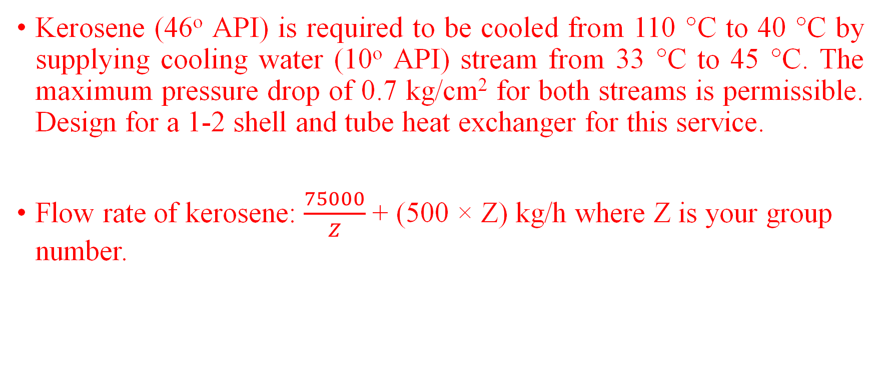
Design Assignment (Shell & Tube HE) - 1
Kerosene (46º API) is required to be cooled from 110 °C to 40 °C by supplying cooling water (10º API) stream from 33 °C to 45 °C. The maximum pressure drop of 0.7 kg/cm² for both streams is permissible. Design for a 1-2 shell and tube heat exchanger for this service.
Flow rate of kerosene: $\frac{75000}{Z}$+ (500 × Z) kg/h where Z is your group number.

Slide 28
Books
Process Heat Transfer, by D. Q. Kern, McGraw Hill, international Student Edition, 1965.
Fundamentals of Heat Exchanger Design by Ramesh K. Shah & Dusan P. Sekulic, John Wiley & Sons, Inc., 2003.
Chemical Engineering, Volume 6, Chemical Engineering Design, by, R. K. Sinnot, Elsevier, Edition 4, 2005.
Process Equipment Design” by L. E. Brownell and E. H. Young, John Wiley & Sons Publications, Reprint 2004
Perry's Chemical Engineers' Handbook, by Don W. Green and Marylee Z. Southard, McGraw-Hill, 9th Edition 2018.
BIS Codes/ASME Codes

Slide 29
Mechanical Design of Heat Exchanger (Shell & Tube)

Slide 30
Mechanical design standards of shell & tube Heat Exchanger
Mechanical design of HE includes design of various pressure & non-pressure parts.
Structural rigidity & satisfactory service of HE depends on appropriate mechanical design.
Mechanical design is generally performed according to design standards & codes. Some mechanical design standards used in heat exchanger design are:
TEMA (United States)
IS:4503-1967 (India)
BS: 3274 (United Kingdom)
BS: 20414 (United Kingdom)

Slide 31
Mechanical design standards of shell & tube Heat Exchanger
Most countries follow TEMA standards
TEMA standards are applicable for maximum shell ID & wall thickness of 60 & 2 inch, a maximum design pressure of 3000 psi & a maximum nominal diameter (inch) × design pressure (psi) of 60000 lb/in, respectively
Three basic classes of TEMA standards are: ‘C’, ‘B’ & ‘R’
Class ‘C’ specifies standards for general service exchangers
Class ‘B’ specifies standards of heat exchangers for chemical services
Class ‘R’ specifies standards of heat exchangers for more severe application in petroleum & related processes

Slide 32
Design considerations
Design pressure & temperature
Materials of construction
Design components
Shell diameter & thickness
Shell cover
Channel covers diameter and thickness
Pass partition plate
Tube sheet thickness
Impingement plates or baffles
Nozzles and branch pipes
Gaskets
Bolts design
Design of flange
Design of supports

Slide 33
Design pressure & temperature
Design pressure:
Design pressure of a HE is gage pressure at top of vessel. This pressure is used to determine minimum wall thickness of various pressure parts. The IS: 4503 design pressure should at least 5% greater than maximum allowable working pressure. Usually a 10% higher value is used.
Maximum allowable working pressure is gage pressure for a specified operating temperature that is permitted for service of exchanger units. According IS: 4503, shell & tube sides pressure should be specified individually.
Design pressure specification is at 250, 120 and 65ᵒC for carbon steel, stainless steel & non-ferrous metals respectively. Maximum permissible stresses for various HE components should not be exceeded at allowable pressure.

Slide 34
Design pressure & temperature
Temperature:
Design temperature is used to determine minimum wall thickness of various parts of exchanger for a specified design pressure. It is normally 10ᵒC greater than maximum allowable temperature.

Slide 35
Materials of construction
All materials used for construction of shell and tube HE for pressure parts must have appropriate specification as given in IS: 4503
Materials of construction should be compatible with process fluids & others parts of materials & also should be cost effective
Maximum permitted operating fluid temperatures should not exceeds for various pressure-retaining components as specified by IS:4503
High chrome-Mo-Ni alloys (Cr content 12-27%) can be used for high temperature services up to 2100ᵒC. Use of any carbon or low alloy steel is not recommended for construction of HE for service below 0ᵒC.

Slide 36
Design components
Shell diameter
Nominal diameter (outside diameter in mm rounded to nearest integer) of HE is specified in IS: 2844-1964 in case of shells manufactured from flat sheet. Following diameters (mm) should be preferably used in case of cylindrical pipe shell: 159, 219, 267, 324, 368, 419, 457, 508, 558.8, 609.6, 660.4, 711.2,762, 812.8, 863.6, 914.4 and 1016.
Shell thickness
Minimum shell thicknesses should be decided in compliance with nominal shell diameter including corrosion allowance as specified by IS: 4503. Usually minimum shell thicknesses are in order for various materials for same service: Cast iron> Carbon steel≥ Al and Al-alloys (up to 700°C)> Cu and Cu-alloys≥ Ni≥ Austenitic stainless steel= Monel inconel

Slide 37
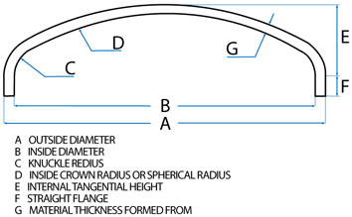
Shell cover
Different types shell covers used in shell and tube HE: flat, torispherical, hemispherical, conical & ellipsoidal
Torispherical head most widely used in chemical industries for operating pressure up to 200 psi
According to IS: 4503, minimum thickness of shell cover should be at least equal to thickness of shell

Slide 38
Channel cover diameter & thickness
Outside diameter of channel shall be same as that of shell. Thickness of channel shall be greater of : (i) shell thickness or (ii) thickness calculated on basis of design shown below pressure.
Effective channel cover thickness (𝑡_{𝑐𝑐} in mm) is calculated from :

Slide 39
Pass partition plate
IS: 4503, specifies that minimum thickness of channel pass partition plates including corrosion allowance should be 10 mm for both carbon steel and alloy upto channel size of 600 mm.
For higher channel size, same should be 13 mm carbon steel and 10 mm for alloy.

Slide 40
Tube sheet thickness
Tube sheet is a circular flat plate with regular pattern drilled holes according to tube sheet layouts. Open end of tubes connected to tube sheet.
Tube sheet is fixed with shell & channel to form main barrier for shell & tube side fluids. Tube sheet is attached either by welding (integral construction) or bolting (gasketed construction) or a combination of both.

Slide 41
Tube sheet thickness
Minimum tube-sheet thickness (TEMA standard) to ‘resist bending’ :
𝐹=1 for fixed tube & floating type tube sheet; 𝐹=1.25 for U-tube tube sheet ,𝐺𝑝=diameter over which pressure is acting (for fixed tube sheet heat exchanger 𝐺𝑝=𝐷𝑠; 𝑓= allowable stress for tube sheet material
Mean ligament efficiency (𝑘):
The effective pressure, 𝑃=𝑃_{𝑠}+𝑃_{𝑏} or 𝑃=𝑃_{𝑡}+𝑃_{𝑏} when tube sheet is extended as a flange for bolting heads.
𝑃_{𝑠}= shell side pressure, 𝑃_{𝑡}= tube side pressure, 𝑃_{𝑏}= equivalent bolting pressure.
For fixed tube sheet & U-tube tube sheet, 𝑃 is effective shell side or effective tube side pressure (TEMA standards)

Slide 42
Tube sheet thickness
The effective tube sheet to ‘resist shear’ is given by:
𝐷_{𝐿} (=4𝐴/𝐶) is equivalent diameter of the perforated tube sheet,
𝐶 is perimeter measured by connecting center to center of outermost tubes of tube layout
𝐴=Total area enclosed by 𝐶
Shear formula does not control tube sheet thickness when:

Slide 43
Impingement plates or baffles
Impingement plates are fixed on tube side between tube bundle & inlet nozzle to deflect liquid or vapour-liquid mixture to protect tubes from erosion
According to IS:4503, protection against impingement may not be required for services involving non-corrosive, non-abrasive, single phase fluids having entrance line values of 𝜌𝑢²<125, where 𝑢 is the linear velocity of the fluid in m/s and 𝜌 is the density in g/cm³.
In all other cases, tube bundle at entrance against impinging fluids should be protected. Usually a metal plate about ¼ inch (6 mm) thick is used as impingement plate.

Slide 44
Nozzles & branch pipes
Wall thickness of nozzles & other connections shall be not less than that defined for applicable loadings, viz, pressure temperature, bending & static loads (IS:4503).
Wall thickness of ferrous piping, excluding corrosion allowance shall never be less than (0.04𝑑_{𝑜𝑐}+ 2.5) mm, where 𝑑_{𝑜𝑐} is outside diameter of connection.
Nozzle size with shell ID

Slide 45
Gaskets
Used to make metal-to-metal surfaces leak-proof
Elasto-plastic materials & relatively softer than flange materials
Deformation of gaskets under load seals surface irregularities between metal to metal surfaces & prevents leakage of fluid
For design pressures<16 kgf/cm² & when there is no contact with oil or oil-vapor, compressed asbestos fiber, natural or synthetic rubber or other suitable gasket & packing materials having appropriate mechanical & corrosion resisting properties may be used (IS:4503).

Slide 46

Gaskets
Preliminary estimation of gaskets is done using following expression: 𝑅𝑒𝑠𝑖𝑑𝑢𝑎𝑙 𝑔𝑎𝑠𝑘𝑒𝑡 𝑓𝑜𝑟𝑐𝑒 = 𝐺𝑎𝑠𝑘𝑒𝑡 𝑠𝑒𝑎𝑡𝑖𝑛𝑔 𝑓𝑜𝑟𝑐𝑒 –(𝐻𝑦𝑑𝑟𝑜𝑠𝑡𝑎𝑡𝑖𝑐 𝑝𝑟𝑒𝑠𝑠𝑢𝑟𝑒 𝑓𝑜𝑟𝑐𝑒)
Residual gasket force should be greater than that required to prevent leakage of internal fluid. This condition results the final expression in the form of:

Slide 47
Gaskets
Gasket factors and minimum gasket seating force

Slide 48

Bolts design

Slide 49

Bolts design

Slide 50
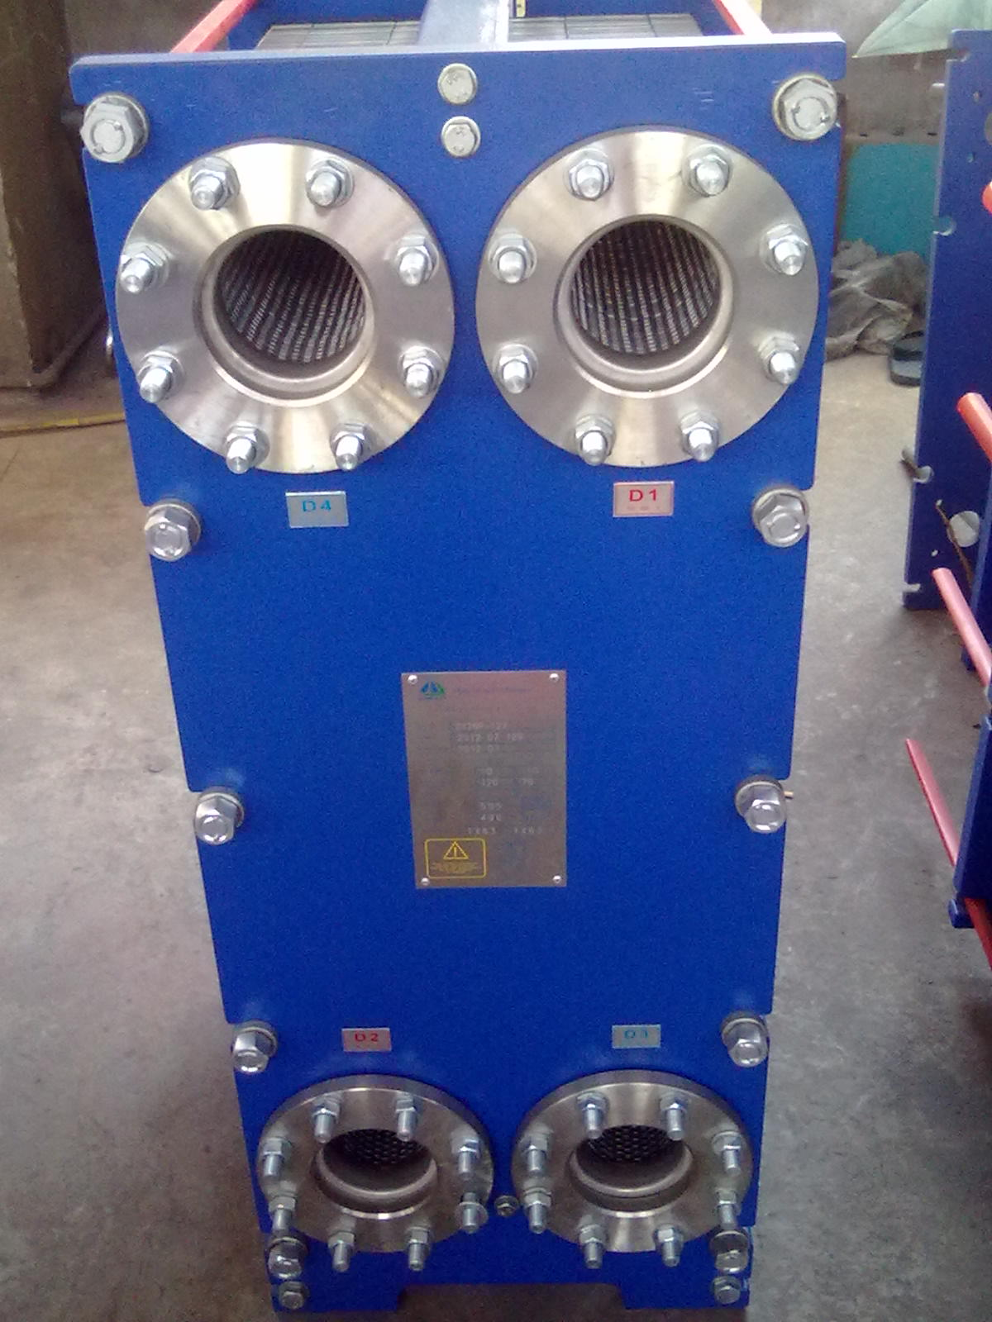
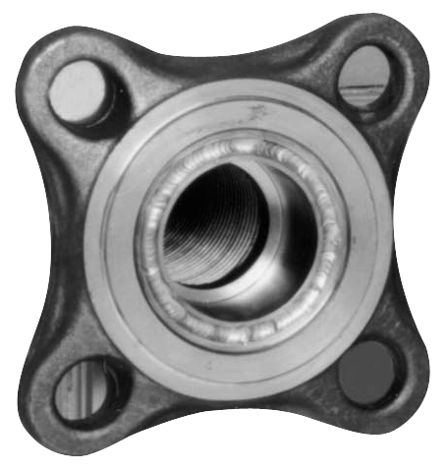
Flange

Slide 51
Design of flange

Slide 52


Design of flange

